Slide 1
The Diffie-Hellman Algorithm

Slide 2
Overview
Introduction
Implementation
Example
Applications
Conclusion

Slide 3
Introduction
Discovered by Whitfield Diffie and Martin Hellman
  “New Directions in Cryptography”
Diffie-Hellman key agreement protocol
  Exponential key agreement
  Allows two users to exchange a secret key
  Requires no prior secrets
  Real-time over an untrusted network

Slide 4
Introduction
Security of transmission is critical for many network and Internet applications
Requires users to share information in a way that others can’t decipher the flow of information
  “It is insufficient to protect ourselves with laws; we need to protect ourselves with mathematics.”
  -Bruce Schneier

Slide 5
Introduction
Based on the difficulty of computing discrete logarithms of large numbers.
No known successful attack strategies*
Requires two large numbers, one prime (P), and (G), a primitive root of P

Slide 6
Implementation
P and G are both publicly available numbers
  P is at least 512 bits
Users pick private values a and b
Compute public values
  x = gª mod p
  y = g^{b} mod p
Public values x and y are exchanged

Slide 7
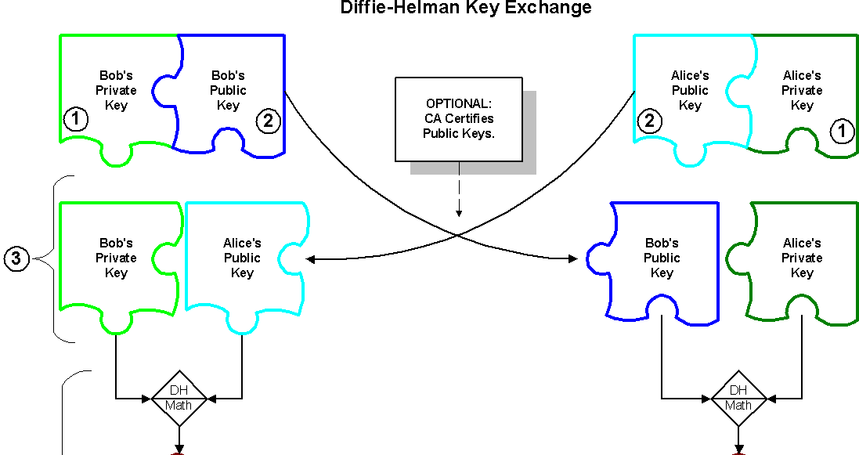
Implementation
Copyright, 2001 by NetIP, Inc. and Keith Palmgren, CISSP.

Slide 8
Implementation
Compute shared, private key
  k_{a} = yª mod p
  k_{b} = x^{b} mod p
Algebraically it can be shown that k_{a} = k_{b}
  Users now have a symmetric secret key to encrypt

Slide 9
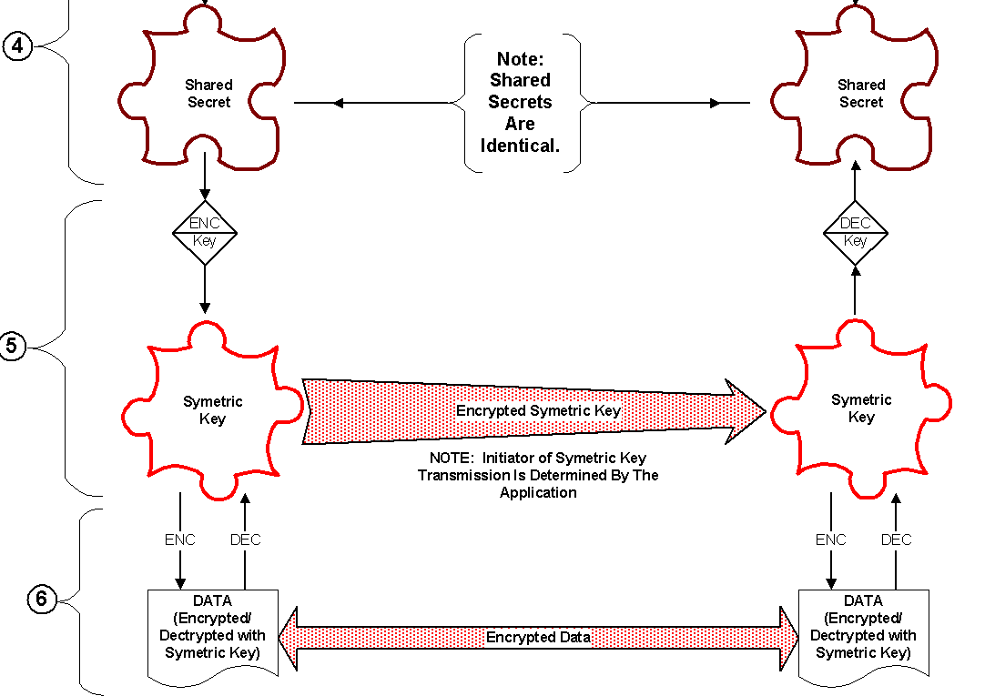
Implementation
Copyright, 2001 by NetIP, Inc. and Keith Palmgren, CISSP.

Slide 10
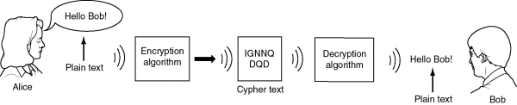
Example
Two Internet users, Alice and Bob wish to have a secure conversation.
  They decide to use the Diffie-Hellman protocol

Slide 11
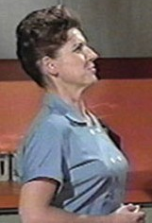


Example
Bob and Alice are unable to talk on the untrusted network.
  Who knows who’s listening?

Slide 12
Example
Alice and Bob get public numbers
  P = 23, G = 9
Alice and Bob compute public values
  X = 9⁴ mod 23 = 6561 mod 23 = 6
  Y = 9³ mod 23 = 729 mod 23 = 16
Alice and Bob exchange public numbers

Slide 13

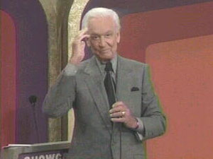
Example
Alice and Bob compute symmetric keys
  k_{a} = yª mod p = 16⁴ mod 23 = 9
  k_{b} = x^{b} mod p = 6³ mod 23 = 9
Alice and Bob now can talk securely!

Slide 14
Applications
Diffie-Hellman is currently used in many protocols, namely:
  Secure Sockets Layer (SSL)/Transport Layer Security (TLS)
  Secure Shell (SSH)
  Internet Protocol Security (IPSec)
  Public Key Infrastructure (PKI)

Slide 15
Conclusion
Authenticated Diffie-Hellman Key Agreement (1992)
  Defeats middleperson attack
Diffie-Hellman POP Algorithm
  Enhances IPSec layer
Diffie-Hellman continues to play large role in secure protocol creation

Slide 16

Additional Sources
http://www.sans.org/rr/encryption/algorithm.php
http://www.hack.gr/users/dij/crypto/overview/index.html

